Slide 1
The Ancient Mariner
Samuel Taylor Coleridge
Presented by:
Jaspal Kaur Matharu
Guest Faculty
Department of English
Gangadhar Meher University

Slide 2
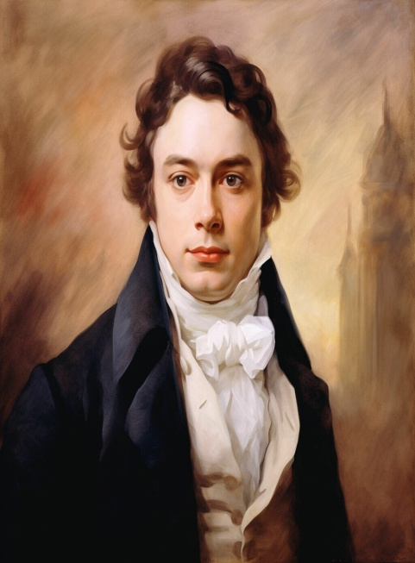
Samuel Taylor Coleridge
Samuel Taylor Coleridge, (born October 21, 177 2- died July 25, 1834 ), English lyrical poet, critic, and philosopher. His Lyrical Ballads, written with William Wordsworth, heralded the English Romantic movement, and his Biographia Literaria (1817) is the most significant work of general literary criticism produced in the English Romantic period.

Slide 3
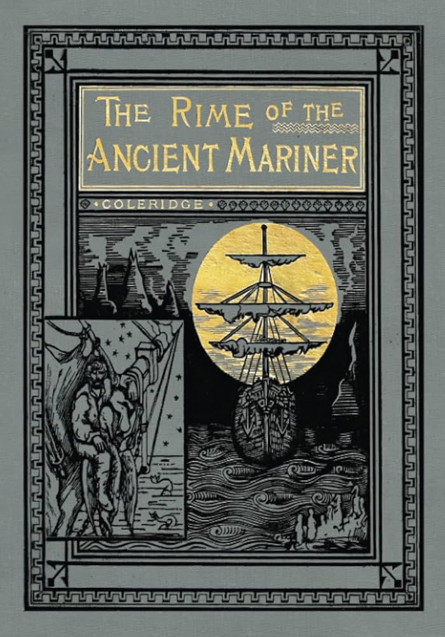
The Ancient Mariner
The Rime of the Ancient Mariner, poem in seven parts by Samuel Taylor Coleridge that first appeared in Lyrical Ballads, published collaboratively by Coleridge and William Wordsworth in 1798. The title character detains one of three young men on their way to a wedding feast and mesmerizes him with the story of his youthful experience at sea—his slaughter of an albatross, the deaths of his fellow sailors, his suffering, and his eventual redemption.

Slide 4
Plot
Part 1
Intent on relating his tale, an old sailor stops a young man on his way to a wedding. The Mariner tells of an ocean voyage with a sailing crew. Once the ship gets blown off course, it ends up at the South Pole, trapped in ice. When an Albatross passes, its presence seems to break the ice surrounding the ship. The crew sails away with the Albatross following. The Mariner then shoots the Albatross for no reason.
Part 2
Believing the bird had brought favourable winds, the crew becomes angry. Then crew members are glad that the Mariner shot the Albatross because they believe the bird brought a thick fog. The ships sails into strange waters and then the wind ceases. Suffering from terrible thirst that drives them mad, the men hang the dead Albatross around the Mariner's neck.
Part 3
The Mariner spies a strange ghostly ship, piloted by Death and Life-in-Death. The two figures roll dice to see who will take the Mariner's soul, and Life-in-Death wins the game. Death takes the lives of the crew, leaving the Mariner the only live person on the ship.
Part 4
The Mariner has no food or water, but still he lives. He watches sea serpents swim in the water, blessing their presence. When the Albatross breaks free from the Mariner's neck, he is suddenly able to pray again.

Slide 5
Part 5
The Mariner sleeps and wakes to find rain that he can drink. As a storm approaches, the ship sails on, seemingly without any wind to propel it. Their bodies taken over by angels, the dead crew members help sail the ship. Suddenly the ship is tossed about and the Mariner falls into a swoon where he hears two voices talking about him and the penance he must do.
Part 6
When the Mariner wakes, night has fallen. The crew members continue to sail the ship until it appears in the Mariner's home harbour. Then the spirits inhabiting the bodies leave, and the crew members collapse, truly dead. A Pilot, his son, and a Hermit approach the ship.
Part 7
The ship sinks, but the Mariner is hauled aboard the Pilot's boat. They are all shocked when he speaks, thinking him dead. When they return to land, the Mariner tells the Hermit his tale. When he is finished, he feels better. The Mariner tells the Wedding Guest that the need to tell his tale grows inside of him and then he must find someone to tell it to or the pain becomes unbearable. His tale told, the Mariner leaves the Wedding Guest, who goes home and ponders what the Mariner told him.

Slide 6
Themes
Supernaturalism
Sin and repentance
Sufferings and agonies
Pride
Christian allegories and morality

